Slide 1
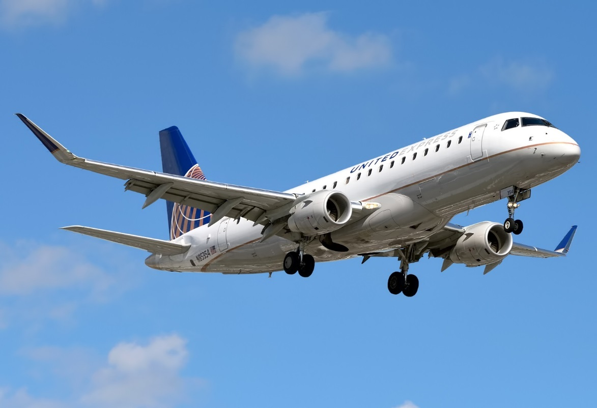

Mesa Airlines, Inc.
Fuel Basics Course

Slide 2
The airport ramp can be busy with congested roadways, different pieces of ground servicing equipment, environmental hazards and various personnel working around aircraft.
All fuel agents must remain aware of their surroundings and notify appropriate personnel of any hazards or safety concerns, and take immediate action to correct the hazard, when able.
It’s important to always remain alert and aware of your surroundings to prevent accidents that could lead to people being injured, killed or damaging aircraft and ground equipment.

Slide 3
Mesa Airlines, Inc. Manual #310
All fueling policies and procedures can be found in the Mesa Fuel Manual (Manual #310) which is available online on the Mesa TechPubs page:
http://mesanet.mesa-air.com/TechPubs/
The policies and procedures in the Fuel Manual must be adhered to when fueling Mesa aircraft.
Note: A login is not required.

Slide 4
Mesa Airlines, Inc. Manual #310
Always use the most current revision of the Mesa Fuel Manual from the Mesa TechPubs website.
General precautions and procedures are in Chapter #2.
Procedures for the CRJ aircraft fleet are in Chapter #3.
Procedures for the E-175 aircraft are in Chapter #4.
ALL PERSONNEL MUST FOLLOW ALL POLICIES AND PROCEDURES OF THE FUEL MANUAL WHEN FUELING MESA AIRLINES, INC. AIRCRAFT.

Slide 5
Noncompliance
All safety hazards should be reported to Mesa’s Manager of Airport Ops & Safety Assurance and the Vice President of Safety and Security.
Hazards can include:
Policy and procedural noncompliance
Unsafe practices
Situations that could impact the safety of flight
Reports can be sent to Fuel@mesa-air.com.

Slide 6
Fire - Emergency Response
STOP FUELING IMMEDIATELY - use the emergency shut-off mechanism if necessary.
Notify the flight crew and direct an evacuation.
  Use any communication possible, including fuel panel interphone, face-to-face communication or relaying via another ramp employee if you’re unable to do so.
Notify the fire department immediately.
Fight the fire using available ramp equipment.

Slide 7
Spills - Emergency Response
Categories
  Small – a pint or less than eighteen square-inches
  Medium – eighteen square-inches up to six square-feet
  Large – six square-feet or if the leak is continuous
Response
  Stop fueling, either by normal operation or the emergency shut-off, and determine the source of the leak.
  Notify the flight crew and confirm if an evacuation is needed.
  Medium/Large spills need to be continuously monitored by someone equipped with at least 1 dry chemical extinguisher that is 20 lbs. (9 kg) or larger.
    Notify the fire department/airport personnel for all medium/large spills.

Slide 8
Smoking
Smoking is prohibited within and around 50 ft. of fueling trucks or equipment, aircraft, where fueling equipment is stored and within 50 ft. of the fuel farm or any fuel storage facilities.
Smoking, or any open flame, could ignite fuel vapors that are close by and cause a fire or explosion that leads to injury or death.

Slide 9
Lightning
  Fueling operations shall be suspended where lightning is present in the immediate vicinity of the airport.
  Each location shall have established criteria for when fueling operations will be suspended due to lightning detected in range of the airport.
  Fueling must not recommence until the lightning is no longer detected near the airport for a period of time, as determined by the local policy.

Slide 10
Static Electricity
  Static electricity is energy that is built up from friction that can be discharged as sparks or an electric current.
  It’s important to be aware that static electricity could cause a fire of explosion if electrostatic bonding precautions are not followed.
  In later lessons, you’ll learn aircraft-specific locations to bond the fuel tender and aircraft. This bond ensures that static build-up from the aircraft or the fuel tender does not create a spark when fueling.

Slide 11
Fuel Agent Precautions
  Matches and cigarette lighters will not be carried by any person engaged in fueling operations.
  Remove any loose objects that could potentially fall into fuel tanks.
  Never wear clothing made of wool or nylon or other synthetic fabrics. These can build up large amounts of static electricity.
  Only wear non-sparking shoes, without any metal spokes or nails located within the base of the shoe.

Slide 12
Conditions Prohibited During Fueling
Maintenance work requiring an open flame or other ignition source.
Use of equipment such as flare pots, open flame lights, welding torches, exposed flame heaters, drills or buffers within 50 ft. of the aircraft.
External power should not be connected or disconnected during fuel servicing.
Aircraft engines must never be operated or running during fuel servicing. All engines must be shut down during fueling.

Slide 13
Fire Extinguishers
Fire extinguisher requirements for fueling equipment and fuel servicing operations:
  Hydrant Carts: One (1) 20 lbs. (9 kg) BC Extinguisher.
  Hydrant carts in Canada are required to have two (2) 20 lbs. BC rated extinguishers.
  Tanker Trucks: Two (2) 20 lbs. (9 kg) BC Fire Extinguishers, mounted on opposite sides.

Slide 14
Using a Guide Person
A guide person must be used when backing fueling equipment up to or away from aircraft in tight spaces.
  This includes anytime a fuel truck is backing out around an aircraft’s wing or must navigate between parked aircraft.
The guide person must remain in the line of sight of the fuel truck driver and provide directions to the driver to ensure the truck remains clear of the aircraft and any other obstacles.

Slide 15
Approaching Mesa Aircraft
Ensure the area around the aircraft is clear and that both engines have been shut down. The flight crew will turn off the rotating beacon lights on the aircraft once this occurs.
Before getting close to the aircraft, test the brakes and ensure they are operating. The truck must remain under control of the operator at all times.
Ensure the aircraft is chocked and, if visible, that the aircraft marshaller has received confirmation of the aircraft parking brake being set.
When approaching a parked aircraft with a fueling truck, do not exceed a speed at which a stop can be safely made with the hand (parking) brake.

Slide 16
Parking Near Mesa Aircraft
For CRJ aircraft, do not park within the Safety Diamond (left). For E-175 aircraft, never park within the 3 ft. no-drive zone (right).

Slide 17
Parking Near Mesa Aircraft
Never position a fuel truck in a way that permits exhaust from the truck to be under any part of the wing or engine nacelle.
Do not park fuel equipment within 10 ft. of the fuel tank vents.
Ensure a clear path of egress is maintained from the aircraft exits and that the fuel truck would not obstruct an evacuation.
When possible, position the fueling vehicle so that it may be rapidly driven or towed away from the aircraft in the event of an emergency.
Keep sufficient space between the fuel truck and any potential obstacle to firefighting equipment in the event of a fire or explosion.
Equipment must never be parked in a manner which could result in damage to an aircraft or other equipment.

Slide 18
Walking Near Mesa Aircraft
Do not walk underneath the aircraft wing unless required for servicing. Never walk or cross underneath the aircraft fuselage.
E-175 Fleet: walking is
permitted under the wing
as depicted in the figure.

Slide 19
Fuel Operation
Never fuel an aircraft unless it has been chocked. Chocks prevent unintended aircraft movement.
All fuel servicing must be done outdoors.
Ensure the aircraft is on level ground.
Never permit a means of egress to be removed from the aircraft while fueling is in progress. If egress is removed, fueling must be stopped immediately.

Slide 20
Fuel Operation
Never drag the fuel hose or fuel nozzle on the ground.
Never leave the overwing nozzle unattended in the fuel filler opening.
Never block or fix deadman controls open.
If an interruption occurs to fueling operations and the fueling connection cannot be attended, the aircraft fueling nozzle must be disconnected and the procedure restarted.

Slide 21
General Fueling Procedures
Always monitor the fuel control panel for warnings and error codes displayed during the fueling operation.
Ensure the flight crew is prepared for and aware that the fuel serving is about to commence.
Ensure a GPU is connected and in use. Aircraft batteries may be used to provide power to the aircraft only if a GPU is not available.

Slide 22
General Fueling Procedures
Prior to making any fuel connections to the aircraft, ensure the fuel tender and aircraft have been properly bonded via an approved, fleet-specific, bonding location to prevent sparks caused by static electricity.
Verify the area beneath the aircraft is and remains free of people and equipment.
Always monitor the total fuel quantity in the main left and right fuel tanks for imbalance limits.

Slide 23
General Fueling Procedures
Any time a high-level tank warning is detected, stop fueling immediately to prevent overfilling the fuel tank.
Fuel in automatic mode whenever possible. If fueling in manual mode, use caution when fueling the tanks to higher capacities, especially during warm weather, as heat causes the fuel and air inside the tanks to expand and can force fuel to spill out of the tank’s vent.

Slide 24
Fueling with Passengers Onboard
Fueling of Mesa aircraft with passengers onboard at the gate is permitted when the following exists:
  The main cabin door is and remains open with the jetbridge/airstairs connected, or door-stairs extended.
  All aircraft exits, and the ground beneath them, must remain clear and available. Nothing may obstruct an aircraft exit’s path during fueling.

Slide 25
Fueling with Passengers Onboard
Fueling of Mesa aircraft away from the gate is permitted when the following exists:
  All aircraft exits, and the ground beneath them, are and remain clear and available. Nothing may obstruct an aircraft exit’s path during fueling.
  All aircraft engines must be shut down.
  Fueling personnel must have contact with the flight crew during fueling away from the gate.

Slide 26
Defueling Policies
No fuel removed from an aircraft with potential contamination can be permitted to be reintroduced into any aircraft, fuel truck or fuel farm facility.
Fuel removed from Mesa aircraft during a defueling procedure may only be placed back into a Mesa aircraft, and must go through filtration again prior to reintroduction.
Prior to the reintroduction of fuel, the following must occur:
  Fuel will be filtered in accordance with the ATA 103, or equivalent standard.
  All defuel equipment must be visually inspected prior to each defueling operation to ensure that it is free from evidence of microbial growth or contamination.
Normal suction defueling for aircraft may be performed by the fuel vendor without the assistance of maintenance personnel. All other defueling operations are required to be performed by, or under the direct control of, Mesa maintenance personnel.
Fuel removed from an aircraft because of possible contamination shall be held in quarantine until laboratory tests have been performed to determine its acceptability.

Slide 27
Fuel Basics
Please continue to the Fuel Basics test. A score of 75% or higher is required to pass.

